Slide 1
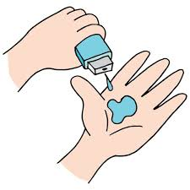
Doctor’s Visit Data Analytics
AMAN SEN,
APPLY_172737580966f5a9c12a590,
SCHOOL OF INFORMATION TECHNOLOGY, RGPV , BHOPAL
UNIVERSITY TEACHING DEPARTMENT,
COMPUTER SCIENCE AND ENGINEERING WITH SPECIALIZATION IN DATA SCIENCE.

Slide 2

PROBLEM STATEMENT
Relation between Health status and Activity reduction using heat map chart.
Count and Visualize the number of Males and Females affected by illness.
Visualize the Percentage of People getting Govt. health insurance due to low income, due to old age. Also calculate the Percentage of People having Private Health Insurance.
Find the number of days of reduced activity of Male and Female separately due to illness and represent via analytical chart.
Analyse how income of People affects the number of visits to the Hospital

Slide 3
Project Description This project visually demonstrates the analytical results obtained after performing crucial and detailed analysis on the doctor’s visit dataset to predict patient’s doctor consultancy patterns and trends.

Slide 4

WHO ARE THE END USERS?
Doctors.
Hospitals’ and Clinics’ administration department.
Patients.

Slide 5

Technology Used
Python Programming Language and its libraries:
Pandas
Numpy
Seaborn
Matplotlib
Jupyter Notebook IDE
Julius AI
Powerdrill AI

Slide 6
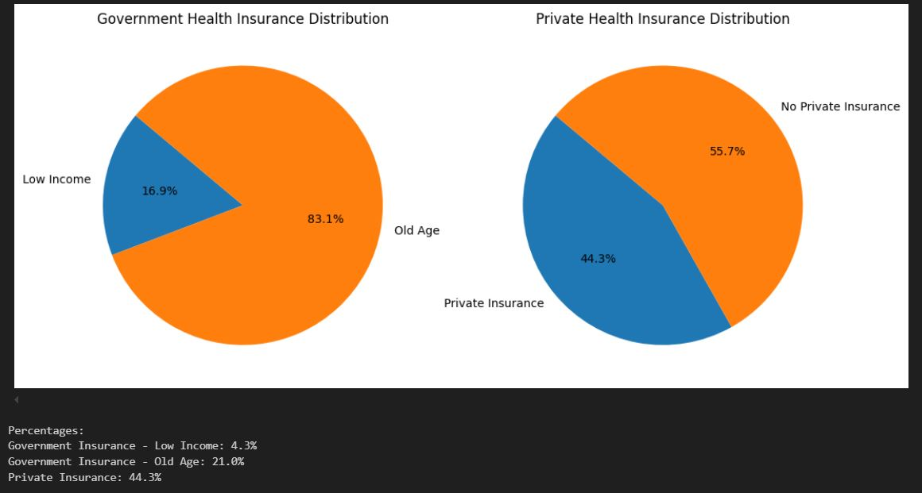
RESULTS
This pie chart describes the percentage of people who took health insurance based upon their income and age.

Slide 7
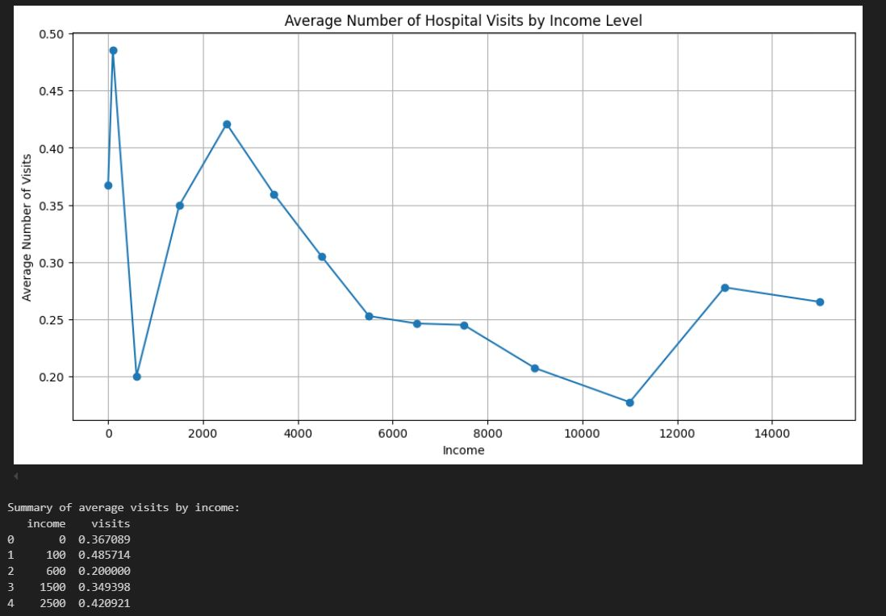
RESULTS
This graph represents the number of people who visited the doctor grouped on the basis of their income.
The summary in the lower left end in the image gives us the average number of visits based upon the tens of thousands of dollars patients earn.

Slide 8
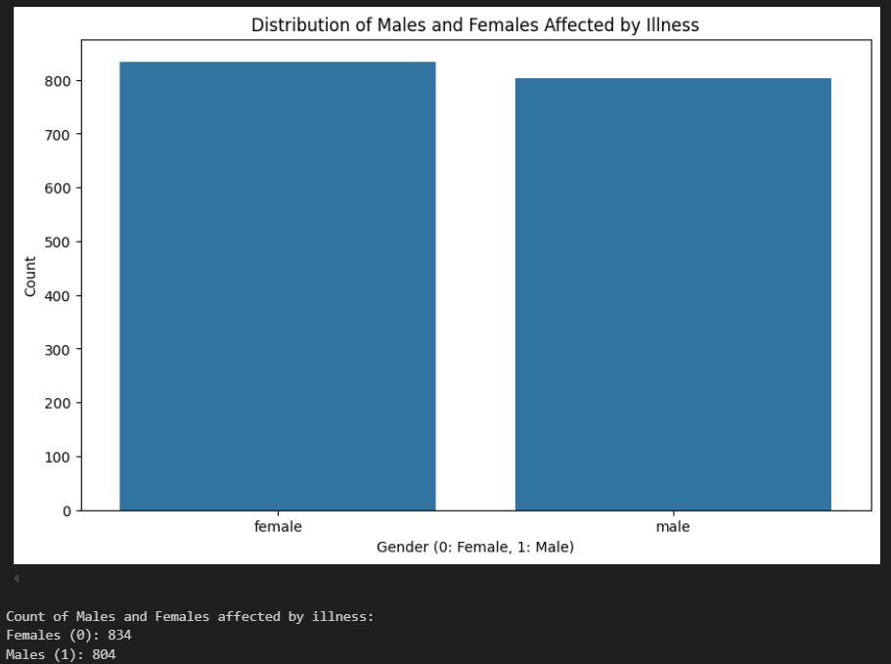
RESULTS
Following bar graph visually depicts the number of male and female count affected by some illness.
The proper number for male is 804 and that for female is 834 as shown in the lower left part of the image.

Slide 9
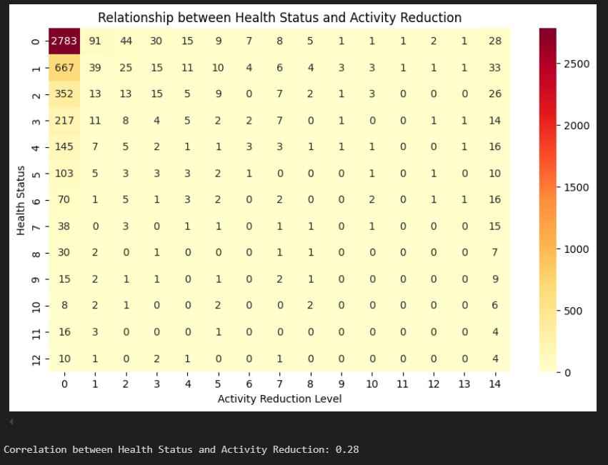
RESULTS
The Heat map as shown on the right depicts the relationship of Health Status and Activity Reduction of the patients.
The correlation value between the two was found to be 0.28 .

Slide 10
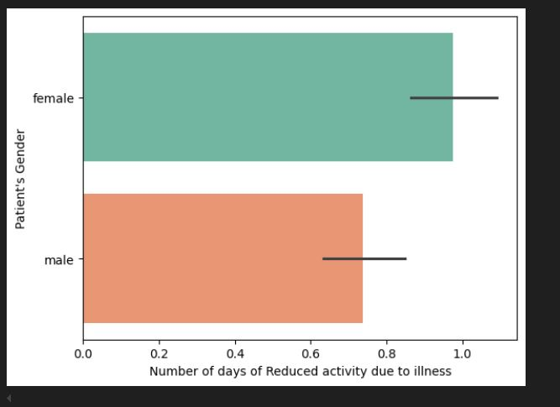
RESULTS
This boxplot gives the number of days of reduced activity due to illness for males and females overall.
For males it lies between 0.6 and 0.8 .
For females it lies between 0.8 and 1.0 .

Slide 11
Thank you
.
.

